Slide 1
TECHNICIAN NETWORKS LTD
ENVIRONMENTAL SOCIAL GOVERNANCE (ESG) PLAN
INVESTING IN TOMORROW

Slide 2
TABLE OF CONTENTS
Technician Networks Ltd
OVERVIEW
MESSAGE FROM
OUR EXECUTIVES.............. 3
EXECUTIVE SUMMARY ........ 5 OUR PURPOSE ................. 7
OUR CORE VALUES ............ 8
OUR ESG PLAN ................. 9 GOALS & OBJECTIVES .........10
ENVIRONMENTAL
ENVIRONMENTAL PILLAR..........................13
GLOBAL ENVIRONMENTAL MANAGEMENT.................15
CLIMATE CHANGE.............17 CIRCULAR ECONOMY........ 18
WATER PROTECTION.........19 SUSTAINABLE PRODUCTS
& SERVICES ................... 20
SOCIAL
GOVERNANCE
SOCIAL PILLAR................ 21
HEALTH & SAFETY ............ 23 WORKPLACE VARIETY....... 24 TRAINING, TALENT
& RECRUITMENT ............. 25
WORKING
ENVIRONMENT ............... 27
SOCIAL ACTIVITIES ........... 30
GOVERNANCE PILLAR........ 31
SUSTAINABILITY GOVERNANCE................. 33
RESPONSIBLE
SUPPLY CHAIN ................36
ANTI-CORRUPTION
& ANTI-BRIBERY.............. 37
BUSINESS CONTINUITY
& CYBER SECURITY ...........38

Slide 3
MESSAGE FROM OUR
EXECUTIVE LEADERSHIP TEAM
Technician Networks Ltd
We are committed to a more sustainable future through environmental stewardship, active community engagement, and fostering trusted relationships that embrace diversity and inclusivity. Technician Networks Ltd continues to build on strong sustainable values and practices, with existing commitments such as Progressive Indigenous Relations, Social Procurement, Community Give Back, and Sustainability. We are dedicated to ingraining these programs everywhere we operate, but as a company, we strive for more—practicing Environmental Social Governance (ESG) with a focus not only on financial returns, but also on how decisions impact people and our planet.
In alignment with the integration of ESG target accountability tied to the Executive Leadership Team, we are committed to ensuring a proactive and collaborative approach is taken to critical environmental, social and governance issues, to create lasting positive change.
We’re proud of the journey we’re on and the progress we are making and hope you will join us.
Technician Networks Ltd ESG Plan 2025 is a framework to integrate and build on our current programs under one umbrella. Our ESG Plan is built on three pillars consisting of Environmental, Social and Governance (ESG). Within each pillar, we have defined the
most relevant lines of action, commitments and
implementation steps that will influence our
decision making.

Slide 4
Technician Networks Ltd
This Environmental Social Governance (ESG) Plan 2025 was developed as a framework
to integrate and build on our current social and environmental programs and practices under one umbrella.
Our ESG Plan is our roadmap, and we understand and are dedicated to achieving these goals and the serious effort, resources, and time required to be successful. Resources are critical to the implementation of our established commitments and goals. Through the addition of appropriate resources there is potential to accelerate certain commitments ahead of the established timelines.
We built and aligned our plan with the critical importance and interests of the next generation of Technician Networks Ltd employees and investing in tomorrow. We encourage you to learn more about what we are doing and the journey we are on and look forward to sharing our progress.
EXECUTIVE SUMMARY
Establishing the ESG Plan aligns with our Key Result Areas (KRA’s) and our purpose. This comprehensive ESG plan involved input from all Technician Networks Ltd business areas and moves us beyond what we say, to actions and showcasing what we do to ensure these commitments become part of who we are.
The development and implementation of our plan formalize action steps and requirements for each commitment we set forth to be measured and validated by our people, our clients, and our community stakeholders. This will provide us with a clear avenue to track progress towards our goals and share our successes.

Slide 5
ABOUT
Technician Networks Ltd
Technician Networks Ltd
Technician Networks Ltdis a leading construction company serving different clients in Kenya.
While our business is Telecommunication, our purpose runs deeper. We are unwavering
in our commitment to enriching the lives of the people who work with us, and in the communities, we help build. With safety at the forefront, we deliver exceptional projects for our clients and communities. Our relationship-based approach, coupled with our expertise, self-perform and Lean capabilities, means we go above and beyond what’s expected, bringing innovative, sustainable solutions that maximize value.
Driven by our purpose and living our core values, we will build better communities and a diverse, resilient company.

Slide 6

OUR PURPOSE
Technician Networks Ltd
Our Purpose is to enrich the lives of the people who work with us and in the communities, we help build.
Driven by our purpose, we are building a sustainable future for our teams and communities, one project at a time.

Slide 7
OUR CORE VALUES
Technician Networks Ltd
Excellent
Health and safety
Workmanship
Ethics
Integrity
Through creative solutions, we break down barriers to deliver on our commitments. We challenge the status quo with new ideas and continuous improvement.
We look after one another. Our focus is on the physical, mental, and emotional well-being of everyone we work with and in the communities, we help build.
With trust and support for each other, we get the job done right by leveraging our collective strengths to overcome challenges and achieve
remarkable results.
We do the right thing for the right reasons, even when it’s difficult.
We are accountable to our team members and continuously look for ways to improve. We do what we say and take pride in delivering results safely.

Slide 8






















OUR ESG PLAN
The United Nations Sustainable Development Goals
Technician Networks Ltd
The UN SDG goals and indicators that are particularly relevant to us include:
Technician Networks Ltd has strengthened its environmental, social and governmental sustainability commitments to ensure long-term enterprise success. Technician Networks Ltd Sustainability Plan 2025 supports and aligns with the agenda 2030 for Sustainable Development and the 17 Sustainable Development Goals (SDGs) formulated by the United Nations.
Technician Networks Ltd has established their own sustainability plans to align with global sustainability vision and
standards, while creating a focus on the things we can do to impact the communities we serve directly.
The United Nations 17 Sustainable Development Goals (UN SDGs) are a comprehensive set of global goals to end poverty, protect our planet, and improve living conditions. At Technician Networks Ltd we use the SDGs as a shared blueprint to assess and track our impact, and contribute towards now and into the future. We have outlined
throughout the plan the specific goals and indicators that align with
our lines of action and commitments.
Good Health and Well-Being
We believe that everyone—our people, clients, partners, and communities deserve a safe, healthy, and secure work environment. We prioritize physical health, mental health and well-being and safety above all else.
Gender Equality
We are committed to actively supporting women in our work community and beyond and being a leader for gender diversity and inclusion within the construction industry.
Climate Action
Building a better future has never been more critical, which is why we are dedicated to reducing our carbon footprint, practicing environmental stewardship, and engaging in sustainable practices.

Slide 9

OVERVIEW
ENVIRONMENTAL
SOCIAL
GOVERNANCE
Technician Networks Ltd
Our ESG Plan defines the framework for ESG specific criteria and recognizes implementation activities depend on the impact they have on individuals, the planet, and our company. Our ESG efforts will be successful when we have implemented and achieved our defined 2025 commitments towards the following:
GOALS AND OBJECTIVES
Positively contribute to our purpose
Be an ethical organization that operates with high integrity
Establish ourselves as a socially responsible, impact- driven company that addresses issues like inequality and social injustice
Doing our part to protect the planet while building a greener future to solve environmental degradation
Taking care of our employees, clients, and the communities where we live, work, play and build
Operate as an organization that our employees, shareholders, owners, clients, and partners, continue to be proud of
Incorporate ESG targets into our daily decision-making process.

Slide 10































OVERVIEW
ENVIRONMENTAL
SOCIAL
GOVERNANCE
Technician Networks Ltd
ESG PLAN 2025
INVESTING IN TOMORROW
Our ESG Plan is built on three pillars—Environmental, Social and Governance (ESG). Within each pillar, we have defined the most relevant lines of action, commitments and implementation steps that will influence our decision making.
Our ESG plan includes established commitments for Phase 1 which are detailed on the following pages. These phase 1 commitments are a 3-year path of progressive actions and steps bringing us to the end of 2025. Focus areas for future phase commitments beyond 2025 have also been identified as a next step in our ESG journey. Our future phase commitments reflect our ongoing dedication to long-term progress and positive change beyond 2025. By allocating the necessary resources, we have the potential to expedite certain commitments ahead of schedule. As our company evolves to meet the changing needs of clients and society, we will nurture these future phase commitments, supporting and investing
in tomorrow.
.

Slide 11



OVERVIEW
ENVIRONMENTAL
SOCIAL
GOVERNANCE
Technician Networks Ltd
OUR ESG PLAN
INVESTING IN TOMORROW
Environmental Pillar
PROTECTING AND SUSTAINING OUR PLANET
Social Pillar
CARING FOR OUR TEAMS, OUR PARTNERS, AND OUR COMMUNITIES
Governance Pillar
ACCOUNTABLE BUSINESS PRACTICES FOR A BETTER WORLD
Our Operations, Our Projects
Our Teams Our Partners
Our Communities
Our Business Our Industry

Slide 12
















OVERVIEW
ENVIRONMENTAL
SOCIAL
GOVERNANCE
Technician Networks Ltd
ENVIRONMENTAL PILLAR
LINES OF ACTION

Slide 13





















OVERVIEW
ENVIRONMENTAL
SOCIAL
GOVERNANCE
Technician Networks Ltd
Protecting and Sustaining Our Planet
We are dedicated to environmental protection and sustainable construction and believe that businesses must play a leading role in innovations and solutions to address the impacts of climate change. We are focused on advancing sustainable building practices with our skilled team of professionals and integrating Lean practices throughout the construction process to reduce waste on all levels.
Our lines of action, commitments, and implementation steps specific to the Environmental pillar are outlined on the following pages.
In alignment with the United Nations 17 SDGs,
the specific goals and indicators that align with our Environmental dimension lines of action and commitments include:

Slide 14


OVERVIEW
ENVIRONMENTAL
SOCIAL
GOVERNANCE
Technician Networks Ltd
GLOBAL ENVIRONMENTAL MANAGEMENT
SUSTAINABILITY AWARENESS TRAINING
THE WHY:
HOW WE PLAN TO DO IT:
OUR COMMITMENT:
By increasing and expanding the internal knowledge across environmental management topics we can establish a solid foundation and use that to further develop sustainable projects for better business practices.
Achieve 100% of employees attending the Sustainability Awareness training.
Offer enhanced second level environmental
sustainability training for all employees.
Track and record all instances of employee sustainability training.
Enhance ongoing communication and up to date awareness across broad spectrum of sustainability topics.
By 2025, increase awareness, knowledge and advocacy among all employees in topics such as sustainable construction operations and buildings, construction waste management and climate impact

Slide 15
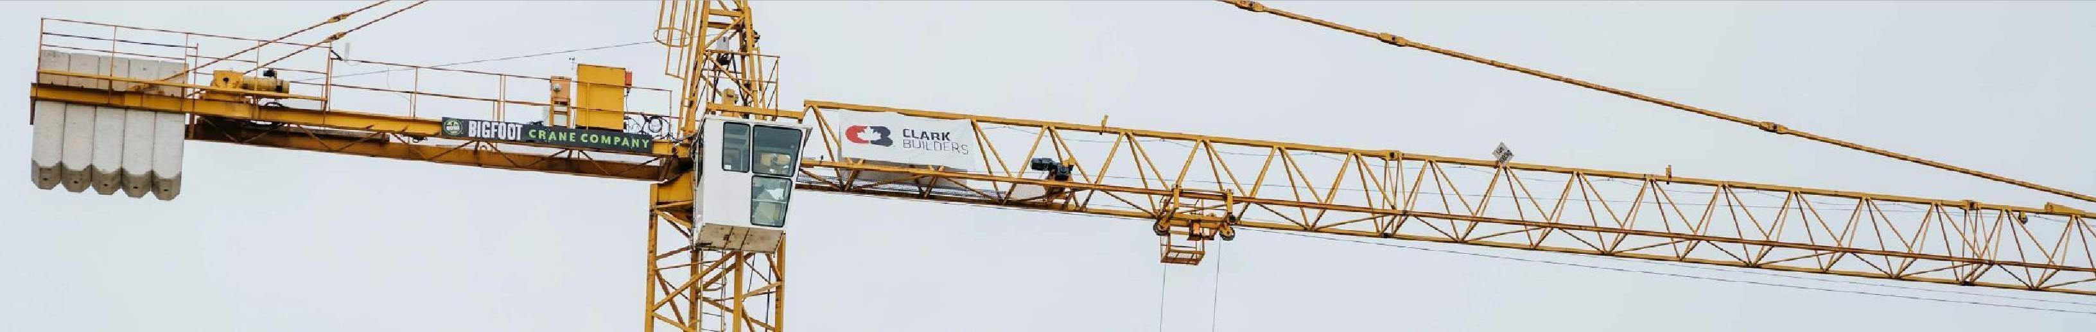
OVERVIEW
ENVIRONMENTAL
SOCIAL
GOVERNANCE
Technician Networks Ltd
GLOBAL ENVIRONMENTAL MANAGEMENT
RECORD ENERGY CONSUMPTION
THE WHY:
HOW WE PLAN TO DO IT:
OUR COMMITMENT:
To support and align our commitments with overall global sustainability vision and standards, while creating a focus on the things we can do to impact the communities we serve directly and ensure accountability.
Establish an accurate tracking program for consistent reporting.
Gather energy data for office and
construction sites.
Establish a baseline for our current state and identify where improvements are required.
Improve data quality through centralized collection, implement improvements, align processes for consistent and proper purchasing, coding and data entry procedures.
To increase the accountability, quality and accessibility of energy consumption information through consistent internal data reporting to all Technician Network Limited employees

Slide 16

OVERVIEW
ENVIRONMENTAL
SOCIAL
GOVERNANCE
Technician Networks Ltd
CLIMATE CHANGE
NET-ZERO CARBON EMISSIONS
THE WHY:
HOW WE PLAN TO DO IT:
OUR COMMITMENT:
Simply, to do our part to reduce the carbon footprint of our business and construction site offices, through greenhouse gas (GHG) reduction and work towards reaching Net Zero.
Consistently track energy consumption and waste production using a centralized sustainability data dashboard.
Build advocacy across the field and offices through the “Sustainability Champions” program, driving a sustainability culture shift and disperse sustainability practices through peer networks.
Advocate externally and promote sustainability leadership among Partners and Owners.
Achieve Scope 1 and 2 annual net-zero carbon emissions for all business and construction site offices by 2038

Slide 17

OVERVIEW
ENVIRONMENTAL
SOCIAL
GOVERNANCE
Technician Networks Ltd
CIRCULAR ECONOMY
C4
WASTE REDUCTION
THE WHY:
HOW WE PLAN TO DO IT:
OUR COMMITMENT:
By finding ways to reuse materials and cut back on waste from our business and construction sites we can make an impact by reducing products and waste sent to landfills.
Determine baseline by using a combination of existing LEED projects and new projects to establish rough waste baseline.
Include a budget for waste management and recycling in all projects.
Develop a how-to guide for site and office recycling identifying major sources of hazardous and non-hazardous waste.
Integrate waste reduction techniques and management, recycling of typical materials and tracking on new projects.
Establish a waste % diversion and reduction commitment.
Determine a baseline for Technician Networks Ltd, waste reduction commitments and reduction of waste sent to landfills.

Slide 18

OVERVIEW
ENVIRONMENTAL
SOCIAL
GOVERNANCE
Technician Networks Ltd
WATER PROTECTION
MONITOR WATER CONSUMPTION
THE WHY:
HOW WE PLAN TO DO IT:
OUR COMMITMENT:
Water is an essential limited resource that must be taken seriously. Implementing water protection plans on our medium to extremely high-risk projects will help to create sustainable solutions to address the challenges and needs for
the future.
Implement water protection plans for projects that are deemed medium, high, or extremely high risk.
Implement water tracking on projects and identify where gaps exist.
Develop education and awareness training for our teams on water preservation.
Develop a water reduction plan that is incorporated into project launch.
Create awareness and protect water resources by measuring and monitoring water consumption on all projects by 2027. Implement water projection plans for projects that are deemed medium, high and extremely high risk

Slide 19

OVERVIEW
ENVIRONMENTAL
SOCIAL
GOVERNANCE
Technician Networks Ltd
SUSTAINABLE PRODUCTS & SERVICES
REDUCE FUEL EMISSIONS
THE WHY:
HOW WE PLAN TO DO IT:
OUR COMMITMENT:
Implementing fuel-efficient or net-zero fleet alternatives to our Equipment contributes to reducing impacts of climate change.
Establish a recurring 2-year plan to review and update the procurement policy to ensure alignment with current market trends, government and client drivers, and technology developments.
Reduce fuel emissions by replacing fleet assets with more fuel efficient, or net zero alternatives.
.

Slide 20
















OVERVIEW
ENVIRONMENTAL
SOCIAL
GOVERNANCE
Technician Networks Ltd
SOCIAL PILLAR
LINES OF ACTION

Slide 21















OVERVIEW
ENVIRONMENTAL
SOCIAL
GOVERNANCE
Technician Networks Ltd
and Our Communities
Social responsibility is a cornerstone of our business approach, enabling us to cultivate a more positive and impactful culture for our people, clients and communities where our lines of action, commitments, and implementation steps specific to the Social pillar are outlined on the following pages.
In alignment with the United Nations 17 SDGs,
the specific goals and indicators that align with our Social dimension lines of action and commitments include:

Slide 22
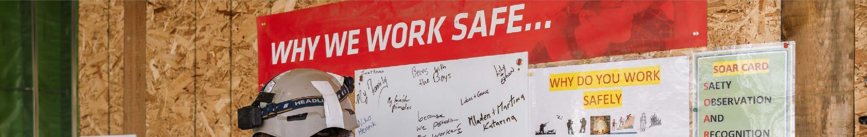

OVERVIEW
ENVIRONMENTAL
SOCIAL
GOVERNANCE
Technician Networks Ltd
HEALTH & SAFETY
HSE PERFORMANCE
THE WHY:
HOW WE PLAN TO DO IT:
OUR COMMITMENT:
We believe that everyone— our teams, clients, partners, and communities deserve a safe, healthy, and secure work environment. We prioritize safety above all else.
Establish a baseline for HSE performance expectations for our trade partners and
ensure prequalification adheres to
updated standards.
Implement Technician Networks LtdSubcontractor Evaluation and Assessment (S.E.A.) card program to inform trade partner selections.
Develop specific mitigation plans for trade partners who do not meet the updated prequalification standards.
Tracking and reporting on all trade partner work hours and HSE performance on Technician Networks Ltdprojects.
Reduce the accident/incident rates of trade partners through communicating and requesting training records and past incident information of the trade partner’s Health and Safety program by 2025

Slide 23
OVERVIEW
ENVIRONMENTAL
SOCIAL
GOVERNANCE
Technician Networks Ltd
WORKPLACE VARIETY
REPRESENTATIONOF WOMEN EMPLOYEES
THE WHY:
HOW WE PLAN TO DO IT:
C8
OUR COMMITMENT:
We recognize our similarities and celebrate our differences in building an inclusive and diverse culture where every team member feels valued, respected, and inspired to make a difference in their communities.
Build connections and align with organizations focused on women in construction and communicate available opportunities.
Develop a consistent presence and cadence to focus on encouraging women in construction, with involvement at schools and job fairs.
Involve our female employees to advocate working with Technician Networks Ltd
Maintain and monitor equitable compensation for all roles, irrelevant of gender.
Increase the total staff representation of women in permanent employee position across Technician Networks Ltd – 35% on a Corporate level and 8% on a Field level by 2030

Slide 24
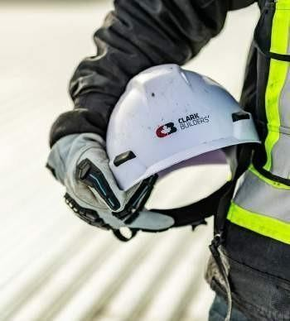
OVERVIEW
ENVIRONMENTAL
SOCIAL
GOVERNANCE
Technician Networks Ltd
TRAINING, TALENT & RECRUITMENT
EMPLOYEE TRAINING & DEVELOPMENT
THE WHY:
HOW WE PLAN TO DO IT:
OUR COMMITMENT:
We are committed to helping our people grow both professionally and personally. That’s why we are committed to providing a wide range of opportunities for skill-building, development, and maintenance of skills.
Publish company-wide objective for updated required training expectations.
Department leaders work with HR to align on required learning objectives for employees in each role type.
Record employee training for tracking and reporting requirements and provide people leaders with resources to facilitate annual follow-up on their teams training progress and successes.
Increase the annual training hours for salaried employees to a minimum of 8 hours per person to contribute to the development and maintenance of a skilled workforce

Slide 25
OVERVIEW
ENVIRONMENTAL
SOCIAL
GOVERNANCE
Technician Networks Ltd
MENTAL HEALTH AWARENESS
THE WHY:
HOW WE PLAN TO DO IT:
OUR COMMITMENT:
We are committed to nurturing a workplace where our employees thrive. Embracing mental health awareness and education,
we strive to erase the stigma and negativity. By fostering understanding and providing
comprehensive training, we empower individuals to effectively manage stress, promoting overall mental well-being among our team members.
Establish clear company-wide objectives for updated required training.
Collaborate with preferred vendors to conduct essential training sessions.
Host annual training sessions, ensuring
salaried employees fulfill required training.
Maintain accurate records of employee training for tracking and reporting purposes.
Equip team leaders with resources to oversee their teams’ training progress annually.
Strengthen communication, awareness, and engagement on mental health topics through our social media platform.
100% of salaried employees trained annually on mental health awareness

Slide 26
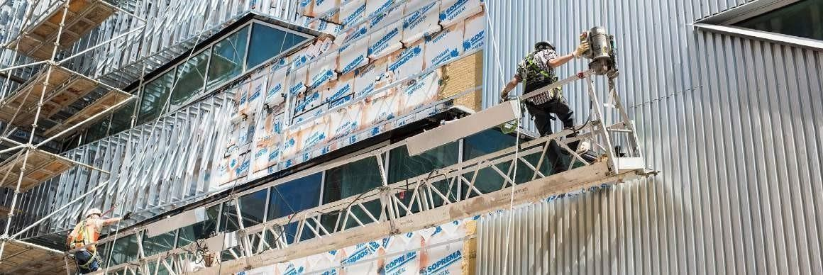
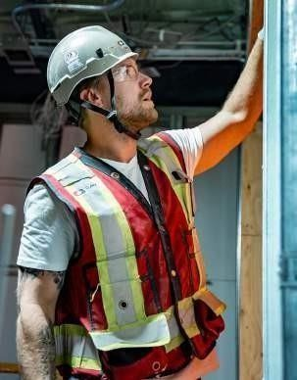
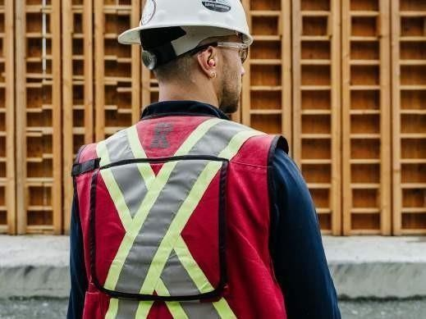
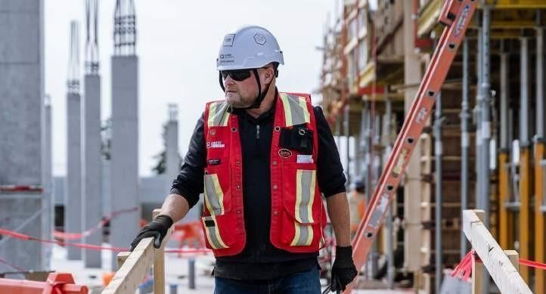
OVERVIEW
ENVIRONMENTAL
SOCIAL
GOVERNANCE
Technician Networks Ltd
WORKING ENVIRONMENT
EMPLOYEE EXPERIENCE
THE WHY:
HOW WE PLAN TO DO IT:
OUR COMMITMENT:
We are dedicated to providing a positive environment complemented with a robust employee recognition program to help employees grow, feel
supported and valued to improve employee job satisfaction.
Analyze exit interview data to determine the main reasons for employees exiting. Take data and work with all departments on implementing changes based on the survey analysis.
Continue to use employee engagement survey results to determine areas of lower employee engagement and implement changes based on the data.
Conduct updated turnover calculation to determine if impact has occurred based on changes implemented.
Sustain overall Technician Networks Ltd turnover rate below construction industry average

Slide 27
OVERVIEW
ENVIRONMENTAL
SOCIAL
GOVERNANCE
Technician Networks Ltd
WORKING ENVIRONMENT
REPRESENTATION OF INDIGENOUS EMPLOYEES
THE WHY:
HOW WE PLAN TO DO IT:
OUR COMMITMENT:
Working together in partnership, we can make positive social and environmental contributions to the communities we serve.
Leverage and communicate our Indigenous Relations Working Committee (IRWC) and Indigenous Employee Resource Group (IERG).
Align with and support Workforce Managers in working with identified organizations to recruit and hire more Indigenous employees.
Support and maintain a positive environment complemented with a robust employee recognition program to help employees grow, feel supported and valued to uphold employee job satisfaction.
Increase the overall staff representation pf indigenous employees to 5% by end of 2030

Slide 28
OVERVIEW
ENVIRONMENTAL
SOCIAL
GOVERNANCE
Technician Networks Ltd
WORK ENVIRONMENT
UNDER REPRESENTED TRADE PARTNERS
THE WHY:
HOW WE PLAN TO DO IT:
OUR COMMITMENT:
We are committed to maximizing local participation in our projects and providing meaningful benefits to the communities where we work, through local and inclusive staffing to enhance employment inclusion and job participation by local suppliers and trade partners.
Establish a modified risk management
application review process for small businesses.
Improve the identification and tracking of Underrepresented trades in Technician Networks Ltdsystems.
Hold annual Indigenous and underrepresented trade partner information sessions on how to grow with Technician Networks Ltd
Increase the number of pre-qualified underrepresented trade partners employed on projects annually

Slide 29
OVERVIEW
ENVIRONMENTAL
SOCIAL
GOVERNANCE
Technician Networks Ltd
SOCIAL ACTIVITY
COMMUNITY GIVE BACK PROGRAM
THE WHY:
HOW WE PLAN TO DO IT:
OUR COMMITMENT:
Community involvement is the cornerstone to building a positive, sustainable, and enriching future. By giving back, we live by our purpose and are active in our communities, contributing to meaningful initiatives that have a lasting impact.
Launch annual internal awareness campaigns on CB goals and Give Back program.
Implement software for internal and external donation application reviews, approvals, and tracking; and managing and reporting program activities.
Publish annual outcomes on donations and volunteering hours and activities internally.
Grow community donations, in-kind contributions, and employee volunteering to 2% of annual net income by 2025

Slide 30











OVERVIEW
ENVIRONMENTAL
SOCIAL
GOVERNANCE
Technician Networks Ltd
GOVERNANCE PILLAR
LINES OF ACTION

Slide 31




















OVERVIEW
ENVIRONMENTAL
SOCIAL
GOVERNANCE
Technician Networks Ltd
The governance factors of decision-making from policymaking to the distribution of rights and responsibilities among employees are critical to our organizational success. Implementing ESG targets into our business and risk framework enables us to develop an environment aligned with our purpose.
Our lines of action, commitments, and implementation steps specific to the Governance pillar are outlined on the following pages.
In alignment with the United Nations 17 SDGs,
the specific goals and indicators that align with our Governance dimension lines of action and commitments include:

Slide 32

OVERVIEW
ENVIRONMENTAL
SOCIAL
GOVERNANCE
Technician Networks Ltd
SUSTAINABILITY GOVERNANCE
ESG MONITORING
THE WHY:
HOW WE PLAN TO DO IT:
OUR COMMITMENT:
To ensure we run our business and projects with the highest integrity and uphold
our commitments.
Working with each group and department, determine the best way to collect and convey
the data based off each commitment
set forth.
Implement all required software and programs to track and measure.
Monitor, adjust and report on progress.
Implementation of Technician Networks Ltd ESG Strategy monitoring systems by 2025

Slide 33
OVERVIEW
ENVIRONMENTAL
SOCIAL
GOVERNANCE
Technician Networks Ltd
ESG INTEGRATION
THE WHY:
HOW WE PLAN TO DO IT:
OUR COMMITMENT:
Implementing ESG targets into our business and risk framework enables us to develop an environment aligned with
our purpose.
Align with appropriate global ESG strategies and policies.
Develop Technician Networks Ltdframework.
Implement and monitor ESG strategy into decision-making.
Integrate ESG targets into the business by incorporating ESG into our decision making by 2025

Slide 34

OVERVIEW
ENVIRONMENTAL
SOCIAL
GOVERNANCE
Technician Networks Ltd
SUSTAINABILITY GOVERNANCE
ESG TARGET ACCOUNTABILITY TO ELT
THE WHY:
HOW WE PLAN TO DO IT:
OUR COMMITMENT:
We are committed to ensuring a proactive and collaborative approach is taken to critical environmental, social and governance issues, to create lasting positive change.
Align with Technician Networks Ltdframeworks for leadership accountability.
Work closely with leaders of the program to adhere to established commitments and timelines and the associated accountability
for Technician Networks LtdExecutive Leadership team.
Monitor and report on ESG target performance.
Integrate ESG target accountability to Executive leadership team performance.

Slide 35

OVERVIEW
ENVIRONMENTAL
SOCIAL
GOVERNANCE
Technician Networks Ltd
RESPONSIBLE SUPPLY CHAIN
ESG PROCUREMENT PROCESS
THE WHY:
HOW WE PLAN TO DO IT:
OUR COMMITMENT:
We are committed to maximizing local participation in our projects and providing meaningful benefits to the communities where we work along the entire supply chain.
Align where appropriate with Technician Networks Ltddata collection policy and criteria.
Integrate formalized ESG data collection and
criteria into our prequalification process.
Communicate and issue roll out for Technician Networks Ltdsubcontracts.
Implement all required software and programs to track and measure.
Include ESG data collection and defining criteria in the procurement process of 50% of projects by 2025

Slide 36
OVERVIEW
ENVIRONMENTAL
SOCIAL
GOVERNANCE
Technician Networks Ltd
ANTI-CORRUPTION & ANTI-BRIBERY
ANTI-CORRUPTION & ANTI-BRIBERY
THE WHY:
HOW WE PLAN TO DO IT:
OUR COMMITMENT:
Through established and available compliance measures we work diligently to prevent violations against our company regulations with bribery and corruption.
Continue annual communication of regulations and conducting training.
Incorporate training for all newly hired employees.
Establish software to record, track and report on employees trained in compliance.
Train 100% of identified employees in compliance

Slide 37

OVERVIEW
ENVIRONMENTAL
SOCIAL
GOVERNANCE
Technician Networks Ltd
BUSINESS CONTINUITY & CYBER SECURITY
C20
SECURITY, CYBER SECURITY & DISASTER RECOVERY
THE WHY:
HOW WE PLAN TO DO IT:
OUR COMMITMENT:
Through formalized policies and plans we work to ensure compliance with regulations, maintain business continuity, and minimize the impact of security incidents to protect our organizational data and assets.
Develop and finalize approved Technician Networks
security policy.
Implement relative cyber security insurance.
Develop and finalize approved and published
Disaster Recovery Plan.
Develop approved security policy with relative cyber security insurance and disaster recovery plan by 2025.

